Slide 1
CSS
Website stylization

Slide 2
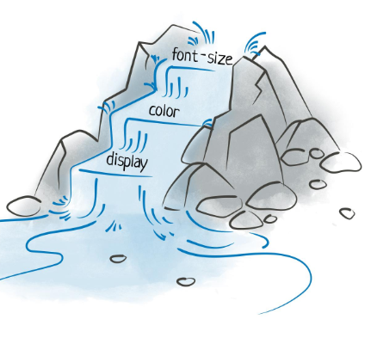
CSS
CSS is an acronym for Cascading Style Sheets. 💡 What do you mean by "cascading"? 👉 Let's imagine a waterfall – water flows from one level to another. 👉 Also, CSS styles are applied from the most general to the most specific rules. 👉 This allows for design control and flexibility. Tables).
Notes:
Teacher Notes:
Explain the meaning of “Cascading” via the waterfall analogy—styles flow from general to specific rules.
Emphasize that CSS separates presentation from content, improving maintainability.
Resources:
MDN – What is CSS?
W3Schools – CSS Introduction
Additional Reading:
CSS: The Definitive Guide by Eric A. Meyer
Learning Web Design by Jennifer Niederst Robbins

Slide 3
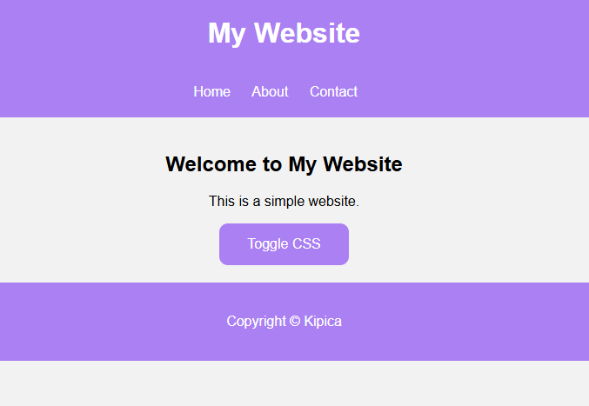
CSS
🎨 CSS transforms plain HTML into an attractive design! 🔹 No CSS – sites are plain, black and white, and boring.
🔹 With CSS – we can change: 🎨 Colors 🔤 Fonts 🖼 Background images 📏 Arrangement and size of elements ✨ Animations and effects
Notes:
Teacher Notes:
Show a plain HTML page and then layer on CSS incrementally (colors, fonts, layout).
Live‑code a minimal HTML page and toggle CSS on/off to illustrate impact.
Site - https://dinoduvnjak.github.io/css-toogle/

Slide 4
CSS‑Tricks – A Complete Guide to CSS
MDN – CSS First Steps - https://developer.mozilla.org/en-US/docs/MDN/Guides

Slide 5
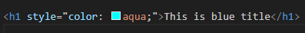
CSS-INLINE CSS
👉 Suitable when you want to quickly change the style of only one element
Problem with Inline CSS 🔹 Difficult to maintain 🔹 Not practical for multiple elements 🔹 It is not used often, except for quick changes
Notes:
Teacher Notes:
Inline CSS (Slide 3): Demonstrate <p style="color:red">…</p> and discuss why it’s only for quick tweaks.
Internal CSS (Slide 4): Show a <style> block in <head>; note duplication across pages.
External CSS (Slide 5): Create a separate .css file, link via <link>; explain caching benefits.
Resources:
MDN – Using Inline Styles
MDN – The <style> Element
MDN – The <link> Element for CSS

Slide 6
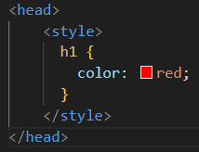
CSS-INTERNAL CSS
👉 Can be used to style the entire page
Problem with Inline CSS 🔹 If the site has multiple HTML pages, you have to repeat the styles in each file

Slide 7
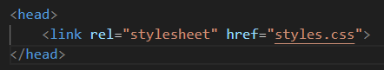
CSS-EXTERNAL CSS
👉 Easier maintenance – all styles in one place 👉 Multiple pages use the same CSS file. 👉 Faster loading – browsers cache CSS
Notes:
Teacher Notes:
Guide students step‑by‑step: create inline.html, internal.html, external.html.
Encourage side‑by‑side file explorer + browser view for instant feedback.
Resources:
Codecademy – Learn CSS

Slide 8
CSS Mastery: Advanced Web Standards Solutions by Andy Budd

Slide 9
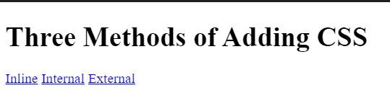
CSS – EXERCISE 1
✅ Objective: Create a page with three links that change the color of the text using all three methods. ✅ Steps: 1️⃣ Create index.html 2️⃣ Add inline.html, internal.html and external.html 3️⃣Uses inline, internal, and external CSS to style titles
Notes:
Teacher Notes:
Guide students step‑by‑step: create inline.html, internal.html, external.html.
Encourage side‑by‑side file explorer + browser view for instant feedback.
Resources:
Codecademy – Learn CSS
CODE - https://github.com/dinoDuvnjak/CTK/tree/main/SHIFT4IT/css-introduction/3.1-methods

Slide 10
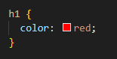
CSS-ELEMENT SELECTORS
💡CSS selectors allow us to select HTML elements and apply styles to them
👉 Apply the style to all h1 elements and HTML files
⚠ Caution! Element selectors apply a style to all HTML elements of that type
Notes:
Teacher Notes:
Element Selectors: Style all <p>, <h1>, etc.
Class Selectors: Reuse .highlight across elements.
ID Selectors: Use #main-header once; discuss specificity cost.
Attribute Selectors: Target [type="text"] inputs.
Universal Selector: Use * { margin:0 } as a reset.

Slide 11
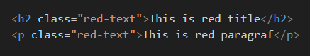
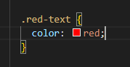
CSS-CLASS SELECTORS
💡CSS selectors allow us to select HTML elements and apply styles to them
👉 Classes are used to group multiple elements that share the same style 👉 You can add the same class to multiple elements!

Slide 12
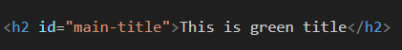
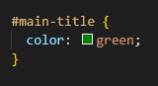
CSS-ID SELECTORS
👉 The ID is unique and is used when you want to style only one element 👉 Each ID must be unique in the HTML document! 👉 Use IDs only when really needed!

Slide 13
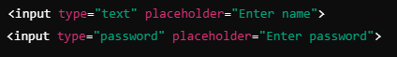
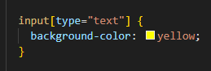
CSS-ATTRIBUTE SELECTORS
👉 With this selector, we can target HTML elements that have a specific attribute 👉 Apply the style only to <input> elements with type="text"

Slide 14
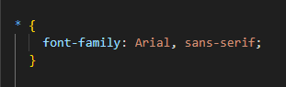
CSS-UNIVERSAL SELECTORS
👉 Apply style to ALL elements in an HTML document 👉 Useful for resetting styles at the beginning of a CSS file!

Slide 15
MDN – CSS Selectors
W3Schools – CSS Selectors Reference

Slide 16
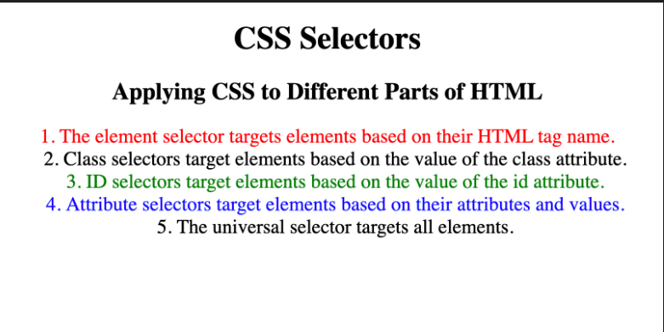
CSS – EXERCISE 2
✅ Objective: Add colors using named colors, HEX, and RGB values. ✅ Steps: 1️⃣ Set the background-color of the page to antiquewhite. 2️⃣ Set the color to h1 using named colors. 3️⃣ Set the color for h2 using the HEX code. 4️⃣ Set background-color for h1 using HEX code. 5️⃣ Set the color for h2 using the RGB value.
Notes:
Slide 12: “CSS – Exercise 2”
Teacher Notes:
Walk through setting background-color and color using named colors, hex codes, and rgb().
Stress consistency: pick a small palette and reuse it.
Resources:
MDN – CSS Color Values
CODE - https://github.com/dinoDuvnjak/CTK/tree/main/Bootcamp/css-uvod/2.2-css-selektori

Slide 17
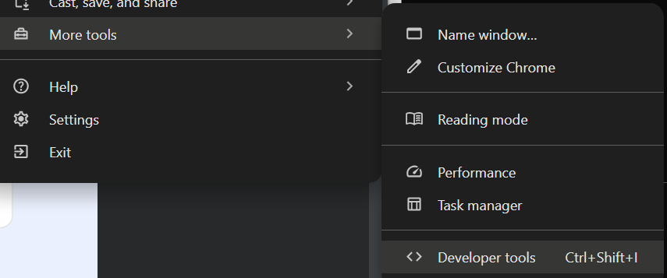
CSS-CHROME DEVELOPER TOOLS
✅ Enable inspection of HTML and CSS code ✅ Detect and test CSS rules ✅ Change live styles without changing the original code ✅ Overview of automatically assigned browser styles
Notes:
Teacher Notes:
Slide 13 (Opening DevTools): Demonstrate all three methods (menu, shortcut, right‑click → Inspect).
Slide 14 (Computed Tab): Show how to diagnose why a style isn’t applied.
Slide 15 (CSS Overview): Use the CSS Overview panel to audit colors, fonts, and unused rules.

Slide 18
CSS-CHROME DEVELOPER TOOLS
🔹 Method 1: Via Menu 1️⃣ Click on the three dots in the top right corner of Chrome 2️⃣ More Tools → Developer Tools 🔹 Method 2: Keyboard Shortcuts 📌 Windows/Linux: Ctrl + Shift + I or F12 📌 Mac: Cmd + Option + I 🔹 Method 3: Right Click (Fastest!) 1️⃣ Right-click on any element on the web page 2️⃣ Click Inspect
Notes:
Teacher Notes:
Slide 13 (Opening DevTools): Demonstrate all three methods (menu, shortcut, right‑click → Inspect).
Slide 14 (Computed Tab): Show how to diagnose why a style isn’t applied.
Slide 15 (CSS Overview): Use the CSS Overview panel to audit colors, fonts, and unused rules.
Resources:
Google Developers – Chrome DevTools Overview
Chrome DevTools – CSS Overview Guide
Additional Reading:
Mastering Chrome DevTools by Jesse Cravens
Debugging with Chrome Developer Tools (Slack Engineering blog)

Slide 19
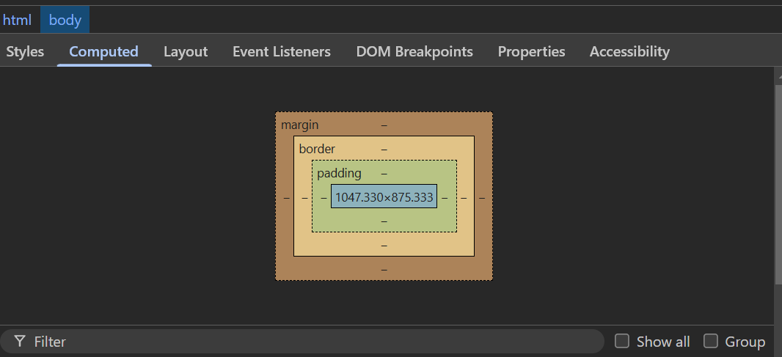
CSS-CHROME DEVELOPER TOOLS
👉 The "Computed" tab shows the final result of all applied CSS rules. ✅ Displays all the colors, margins, fonts, and other properties of an element ✅ Ignores strikethrough rules that are not active ✅ Allows you to diagnose problems faster Example: If the color of the text does not appear as you expected, you can see in the Computed section which CSS rule takes precedence.

Slide 20
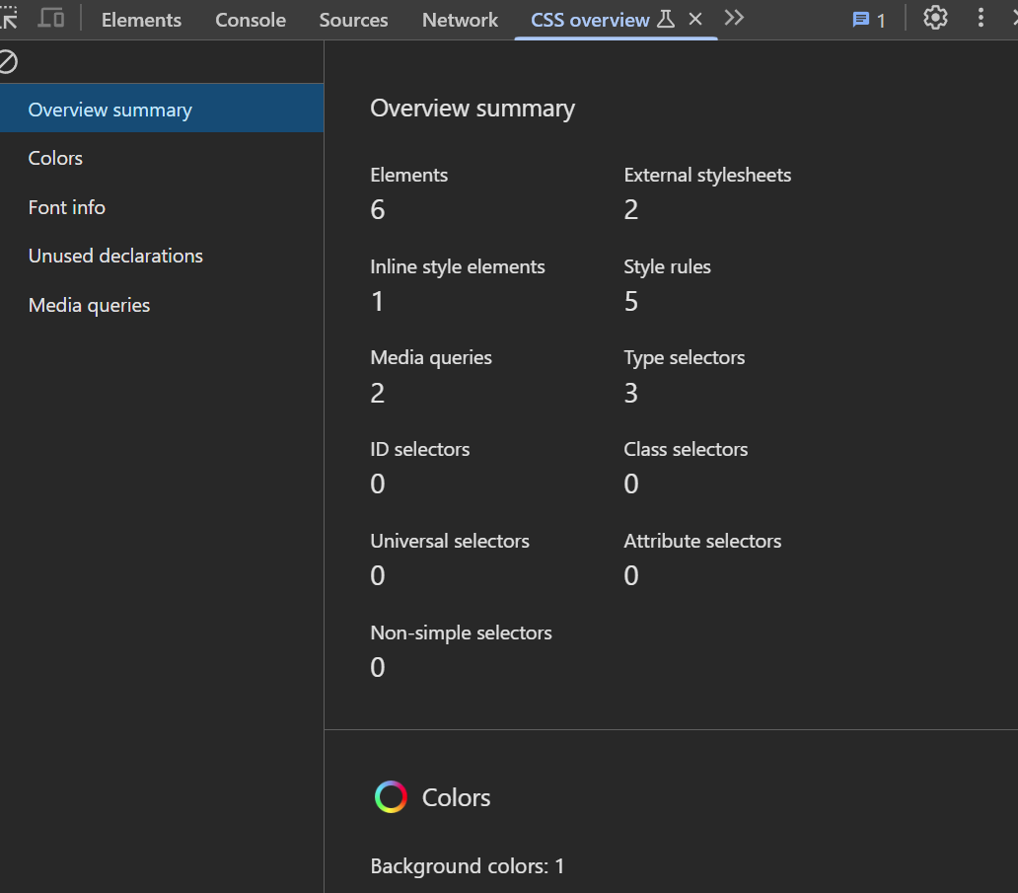
CSS-CHROME DEVELOPER TOOLS
✅ All colors on the page (background, text, links) ✅ What fonts are used ✅ What font sizes are applied
🔍 Useful trick: If you see an interesting color on a web page, you can use CSS Overview to quickly get its code and use it in your project.

Slide 21
Google Developers – Chrome DevTools Overview
Chrome DevTools – CSS Overview Guide
Mastering Chrome DevTools by Jesse Cravens
Debugging with Chrome Developer Tools (Slack Engineering blog)

Slide 22
CSS-BOX MODEL
Each HTML element consists of:
Content – Text, image, paragraph, title, etc. Padding – Inner Spacing Between Content and Border Border – A line that surrounds an element Margins – The space between an element and other elements
Notes:
Slide 16: “CSS – Box Model”
Teacher Notes:
Live‑inspect element in DevTools to show content, padding, border, and margin.
Explain how box-sizing: border-box; alters box calculations.

Slide 23
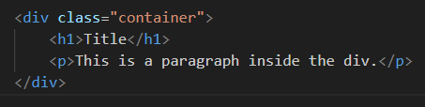
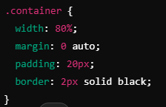
CSS-DIV ELEMENT
👉 Sometimes it is necessary to group elements into "containers" to make it easier to add styles to them. 👉 <div> It allows flexibility in the arrangement of elements on the page.
Notes:
Teacher Notes:
Explain that <div> is a generic container; discuss semantic alternatives (<section>, <article>).
Show grouping of elements into flex or grid containers.

Slide 24
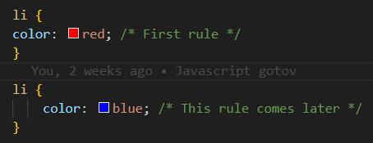
CSS-CASCADE AND SPECIFICITY
💡How CSS decides which style to apply when there are multiple rules for the same element
👉A rule that is lower in the CSS file has a higher priority and can override predefined rules. 👉 The text <li> will be blue, because the second rule comes later and overruns the first.
Notes:
Teacher Notes:
Slide 18 (Cascade): Demonstrate rule order in CSS file affecting output.
Slide 19 (Selector Priority): Walk through element → class → attribute → ID ranking.
Slide 20 (Inline Style Priority): Show inline styles beating all external/internal rules.
Slide 21 (!important): Warn about maintenance headaches—reserve for special cases only.

Slide 25
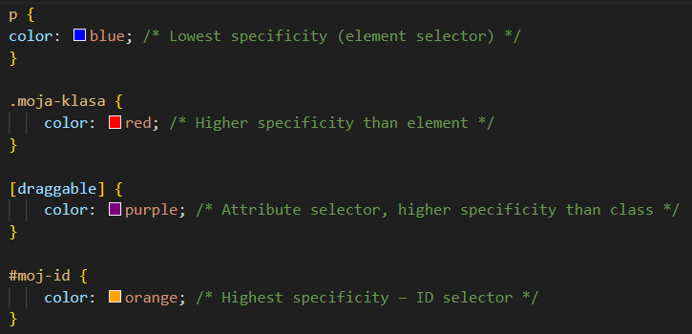
CSS-STYLE TYPE PRIORITY
👉The CSS specificity determines which selector takes precedence. Rules with more specifics will beat less specific ones. 1️⃣ Element selector (p, li, h1) 2️⃣ Class selector (.my-class) 3️⃣ Attribute selector ([type="text"]) 4️⃣ ID selector (#moj-id)

Slide 26
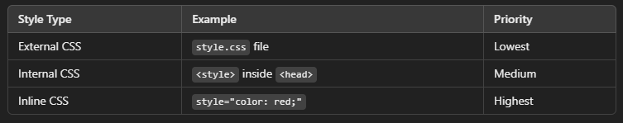
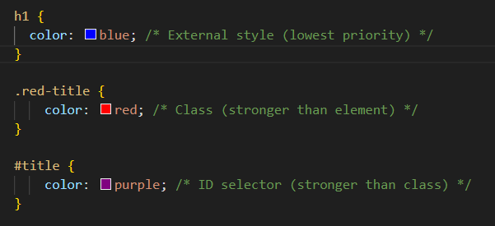
CSS-SELECTOR SPECIFICITY PRIORITY
👉The text will be green, as the inline style has the highest priority

Slide 27
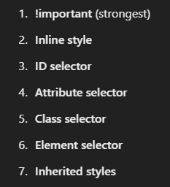
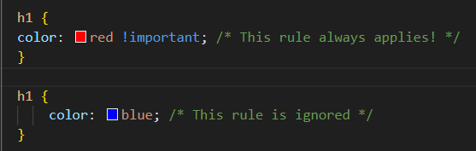
CSS-!important RULE
👉If you want to make sure that a rule always applies, use !important
Excessive use of !important can complicate the maintenance of CSS. Use it only when it's necessary.

Slide 28
Resources:
MDN – Cascade and Inheritance
MDN – Specificity
MDN – Using !important
MDN – The <div> Element
CSS: The Definitive Guide by Eric A. Meyer (box model chapter)

Slide 29
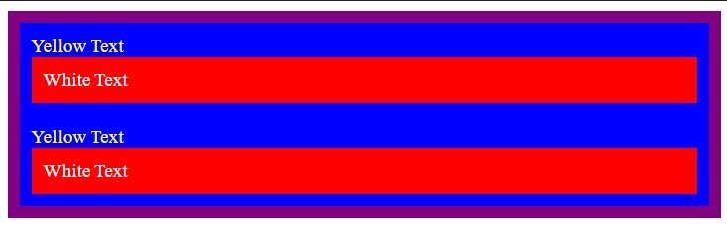
CSS – EXERCISE 3
👉Replicate site from image
Notes:
Teacher Notes:
Provide the reference image and challenge students to replicate layout, colors, and typography.
Encourage use of Flexbox or Grid if they wish, even though it’s not yet covered.
CODE - https://github.com/dinoDuvnjak/CTK/tree/main/Bootcamp/css-uvod/2.3-css-cascade

Slide 30
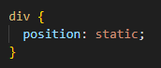
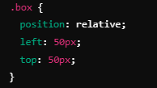
CSS – POSITIONING
Static (default)
Relative
👉Elements are lined up one below the other in HTML order
👉The element moves 50px to the right and 50px down, but does not affect the other elements.
👉 It doesn't move in relation to other elements, only to its original position.
Notes:
Teacher Notes:
Slide 23 (Static & Relative): Demonstrate position:relative; top/left offsets.
Slide 24 (Absolute & Fixed): Show absolute positioning within a relative parent and fixed headers.
Slide 25 (Z‑Index): Illustrate stacking context and how higher z-index brings elements forward.

Slide 31
CSS – POSITIONING
Absolute
Fixed
👉 An element moves relative to its nearest parent, which has position:relative 👉 If neither parent has a postion set, then it is positioned towards the upper left corner. 👉 Key problem with absolute: An element goes out of the normal flow of the document, so the other elements behave as if it doesn't exist.
👉 The element remains in the same place on the screen, even when the user scrolls. 👉 It is used for navigation, back to top buttons, chat windows, etc.

Slide 32
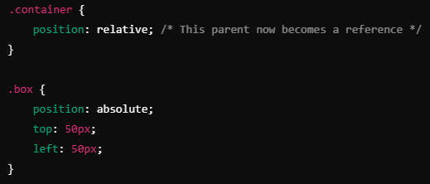
CSS – POSITIONING
Z-index
👉 The z-index determines which element goes above which in the "third dimension" (Z-axis). 👉 The higher the value of → element goes above the others.

Slide 33
MDN – CSS Positioning
Frontend Mentor Challenges
MDN – Z‑Index
CSS Secrets by Lea Verou (positioning techniques)
CSS Mastery by Andy Budd

Slide 34
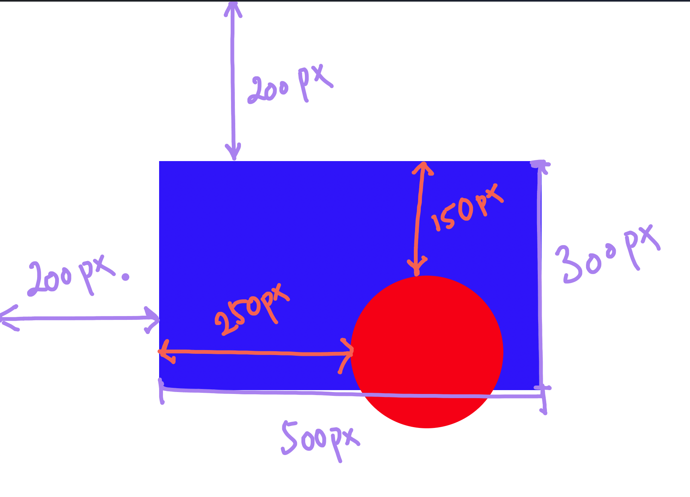
CSS – EXERCISE 4
👉Replicate site from image 👉 Read and go through the exercises at W3 schools
Notes:
Teacher Notes:
Assign a layout mockup that requires precise positioning and layering.
Advise use of DevTools to tweak top, left, and z-index interactively.
Resources:
CodePen – Z‑Index Playground
CODE - https://github.com/dinoDuvnjak/CTK/tree/main/Bootcamp/css-uvod/2.4-positioning

Slide 35
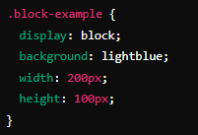
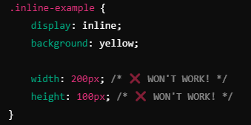
CSS – DISPLAY
Block
Inline
👉 By default, some HTML elements occupy the entire width of the page, even if their content is not wide. 👉 Examples: <p>, <div>, <h1>, <section>, <article>, <footer>.
👉 These elements only take up as much space as they need. 👉 We cannot set their width (widght) or height (height). 👉 Examples: <span>, <a>, <strong>, <em>. 👉 The elements will stand next to each other and ignore the width and height.
Notes:
Teacher Notes:
Slide 27 (Block vs Inline): Show how block elements stack and inline elements flow.
Slide 28 (Inline‑Block & None): Demonstrate inline‑block allowing width/height vs display:none hiding elements altogether.

Slide 36
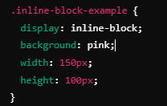
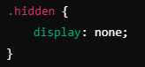
CSS – DISPLAY
Inline block – best from both worlds
None – hiding elements
👉 It hides the element completely – as if it were not in HTML! 👉 It doesn't even take up space on the schedule. 📌 It is used for: Hide the menu until the user clicks the button. Removal of elements on the mobile versions of the site
👉 It combines the characteristics of block and inline elements. 👉 It can have width and height, but does not move to a new row if there is enough space. 👉 The elements will remain in the same row, but now we can adjust the width and height.

Slide 37
MDN – Display

Slide 38
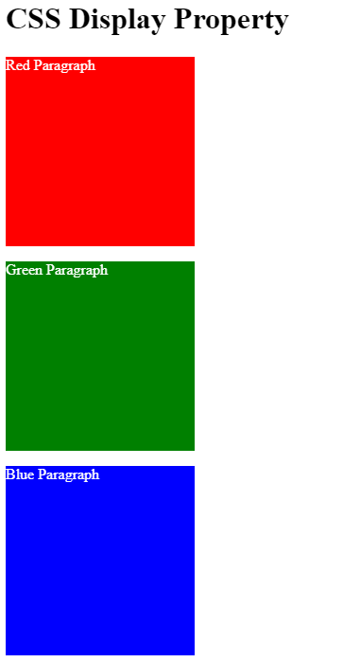
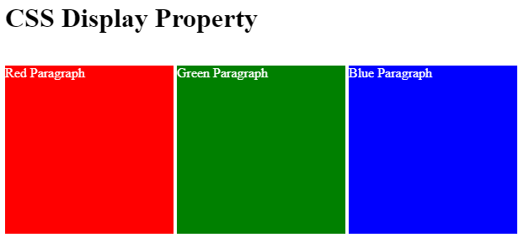
CSS – EXERCISE 5
👉Adjust the display so that the three squares stand in the same row. 👉 Adjust the display so that all the squares stand one below the other.
Notes:
Teacher Notes:
Provide a simple grid of three squares and ask students to toggle between row and column layouts using display.
Resources:
CSS‑Tricks – A Complete Guide to Flexbox
CODE - https://github.com/dinoDuvnjak/CTK/tree/main/Bootcamp/css-uvod/2.5-css-display

Slide 39
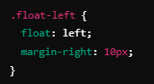
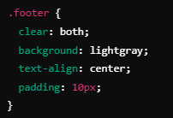
CSS – FLOAT
👉 Float allows us to wrap text around elements, such as images, and create designs with "floating" blocks
After elements that use float, sometimes it is necessary to clean the floating effect. 👉 We use clear: both; to ensure that the elements underneath are not stuck.
⚠️ Float is best for: ✅ Wrap text around a picture 🖼️ ✅ Simple Floating Elements
Notes:
Teacher Notes:
Slide 30–31 (Float Concepts): Explain text wrapping around floated elements and why floats aren’t recommended for complex layouts.
Slide 32 (Exercise 6): Ask students to float elements in a row, then clear the float for elements below.

Slide 40
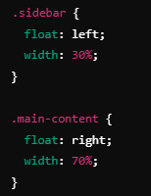
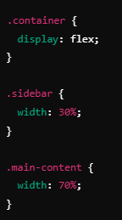
CSS – FLOAT
Good practice
Bad practice
🚫 Float is NOT a recommended technique for complex layouts. ✔ Better to use Flexbox and CSS Grid.

Slide 41
MDN – Float
CSS‑Tricks – A Complete Guide to Floats
Learning Web Design by Jennifer Niederst Robbins (float chapter)
Responsive Web Design by Ethan Marcotte

Slide 42
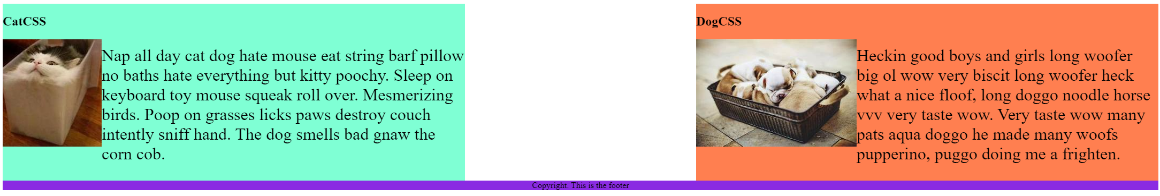
CSS – EXERCISE 6
👉Adjust the display so that the three squares stand in the same row. 👉 Adjust the display so that all the squares stand one below the other.
Notes:
CODE - https://github.com/dinoDuvnjak/CTK/tree/main/Bootcamp/css-uvod/2.6-css-float

Slide 43
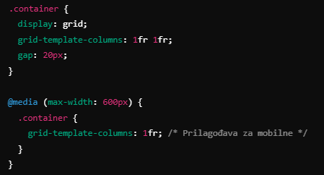
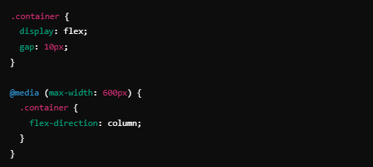
CSS – RESPONSIVNESS
CSS Grid
Flexbox
💻 Desktop → Two columns 📱 Mobile → Single Column
💻 Desktop → Elements are OK (horizontal) 📱 Mobile → Elements are stacked vertically
👉 It allows you to create complex layouts using rows and columns. 👉 CSS Grid is powerful for complex layouts and allows us to easily control the widths and heights of elements.
👉 Flexbox is great for navigation menus, buttons, and in-line arrangement of elements.
Notes:
Teacher Notes:
Slide 33 (Flexbox & Grid): Compare use cases—Flexbox for one‑dimensional layouts, Grid for two‑dimensional.
Slide 34 (Bootstrap, Tailwind, Bulma, Kendo): Show code snippets from each and discuss trade‑offs between custom CSS vs utilities/frameworks.

Slide 44
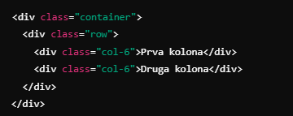
CSS – RESPONSIVNESS
Bootstrap
Alternatives
👉 TAILWIND CSS
👉 BULMA
👉 KENDO
💻 Desktop → 2 columns (50% - 50%) 📱 Mobile → Automatically moves to 1 column
👉 Bootstrap provides ready-made styles and predefined classes for a simple design without a lot of coding

Slide 45
MDN – Flexbox
MDN – Grid
Bootstrap Documentation
Tailwind CSS Documentation
Bulma Documentation

Slide 46
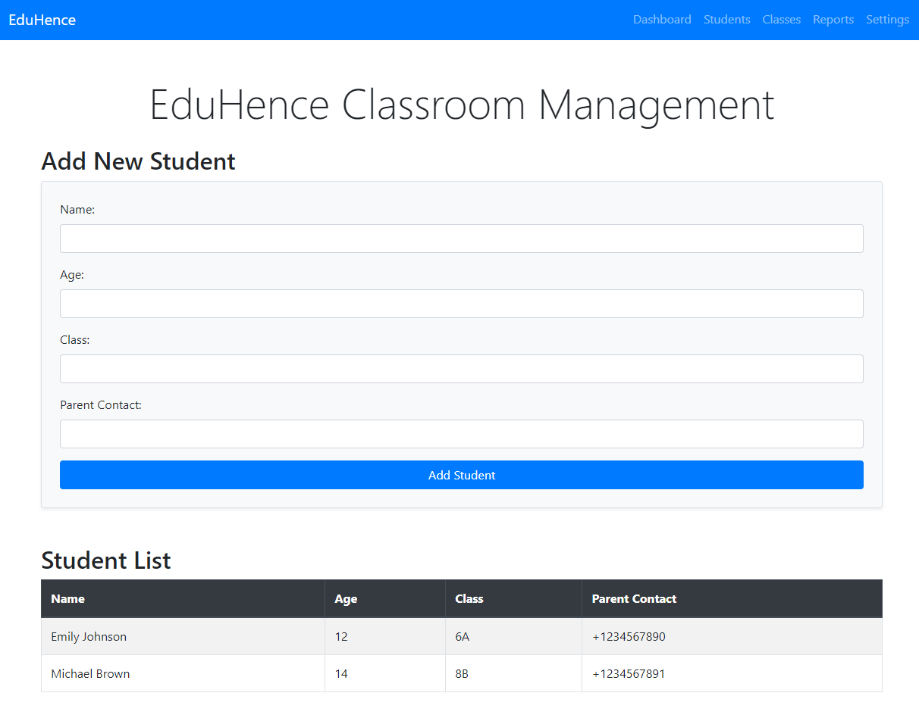
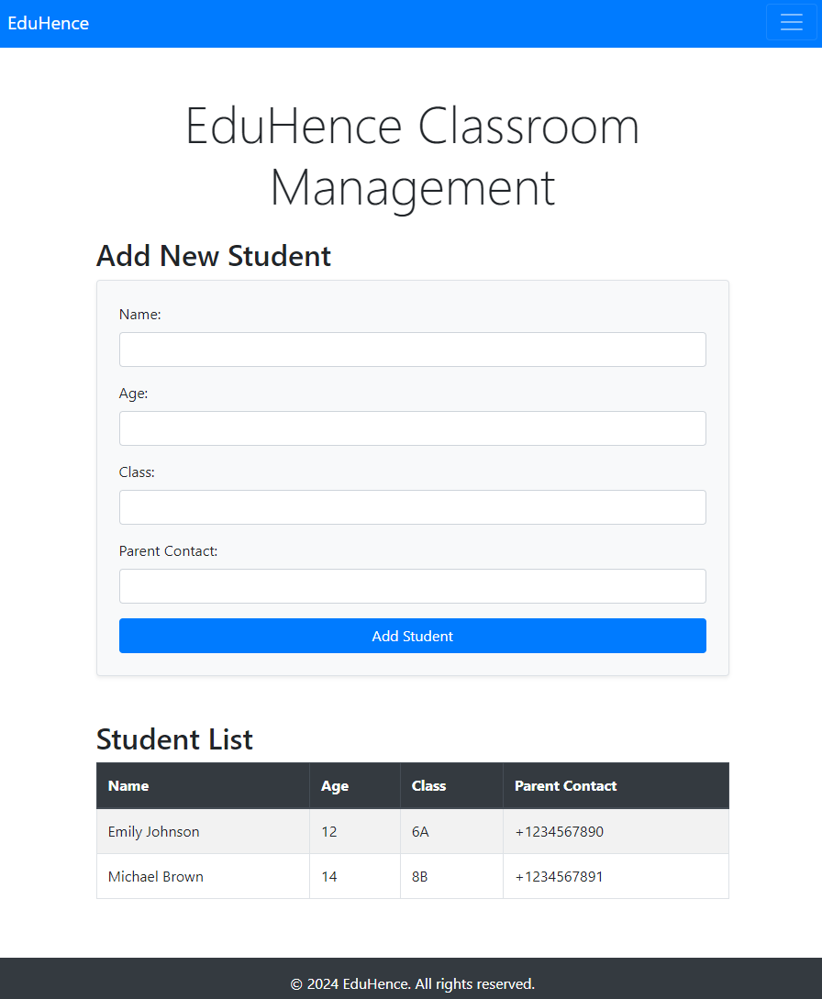
CSS – FINAL EXERCISE
Enhance Your Classroom Management Website with CSS and Responsive Design
✅ Add CSS Styling:
Improve the look and feel of your classroom management website by adding custom CSS styles.
Ensure that the design is visually appealing and consistent.
✅ Use a Responsive Framework:
To make development easier and ensure responsiveness, use any popular framework like Bootstrap, Bulma, or any other framework of your choice.
✅ Ensure Full Responsiveness:
The website should be fully responsive, adapting seamlessly to both mobile and large screens.
Optimize the layout and elements to provide a smooth user experience on different screen sizes.
✅ Update on GitHub:
Once the improvements are complete, commit and push the updated code to your GitHub repository.
👉 This will make your site more professional and user-friendly across all devices! 😎
Notes:
Teacher Notes:
Clearly restate project requirements: styling, responsiveness, framework use, GitHub deployment.
Offer a checklist and rubric for grading (visual design, code quality, responsiveness, version control).
Resources:
GitHub Guides – Hello World
FreeCodeCamp – Responsive Web Design Certification
CODE - https://github.com/dinoDuvnjak/CTK/tree/main/SHIFT4IT/css-introduction/3-final-exercise

Slide 47
CSS – FINAL EXERCISE
Notes:
Teacher Notes:
Clearly restate project requirements: styling, responsiveness, framework use, GitHub deployment.
Offer a checklist and rubric for grading (visual design, code quality, responsiveness, version control).
Resources:
GitHub Guides – Hello World
FreeCodeCamp – Responsive Web Design Certification
CODE - https://github.com/dinoDuvnjak/CTK/tree/main/SHIFT4IT/css-introduction/3-final-exercise

